Slide 1
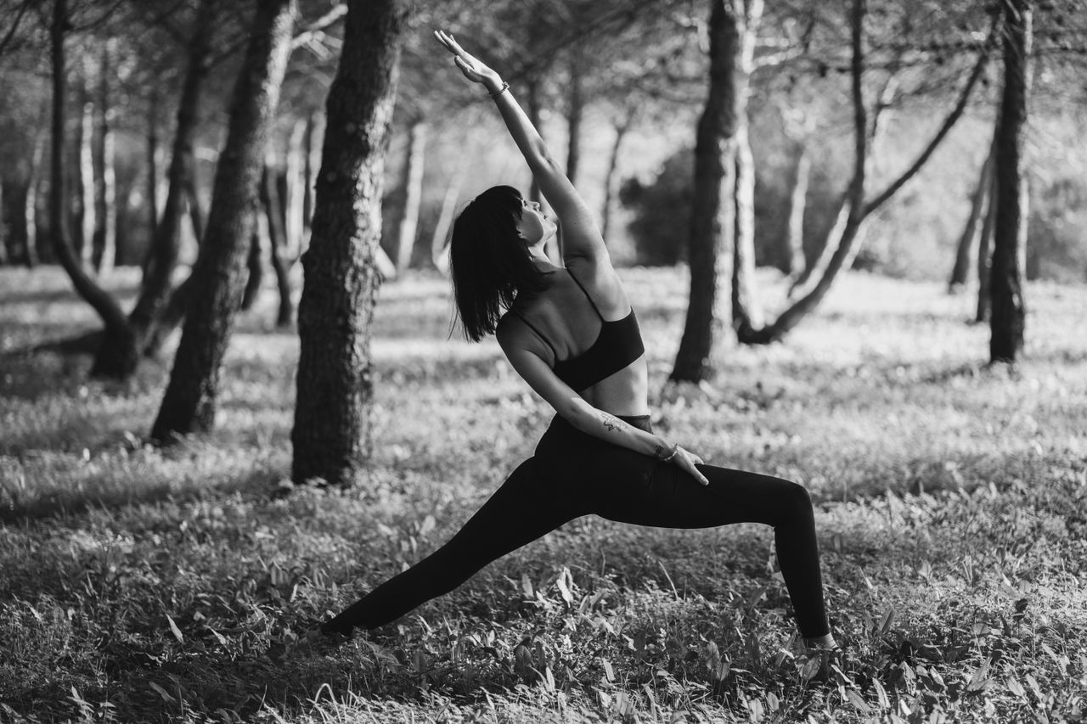
Handling
Big Feelings
Grades 4–6
Together For Health

Slide 2

🌊
Stress Is Normal!
Everyone feels stressed sometimes — even adults.
Stress is your body getting ready to handle a challenge. It is helpful in small doses.
Together For Health

Slide 3

😰
What Does Stress Feel Like?
Fast heartbeat
Butterflies in your stomach
Feeling worried or nervous
Trouble sleeping or concentrating
Sometimes — headaches or stomachaches
Together For Health

Slide 4
💚
Good Ways to Handle Stress
Deep breathing: breathe in 4 counts, hold 4, out 4
Move your body — even a 5-minute walk helps
Talk to someone you trust about what is bothering you
Break big problems into small steps
Do something creative: draw, write, play music
Together For Health

Slide 5
🧘
The 5-4-3-2-1 Grounding Technique
Name 5 things you can SEE right now
1
Name 4 things you can TOUCH
2
Name 3 things you can HEAR
3
Name 2 things you can SMELL
4
Name 1 thing you can TASTE
5
Together For Health

Slide 6
KEY TAKEAWAYS
Stress is part of life — and you can handle it
✓
Small coping tools used regularly make a big difference
✓
You never have to deal with big stress alone — ask for help
✓
Resources
Kids Help Phone: 1-800-668-6868
Mindfulness: calm.com or headspace.com (free tier)
Talk to a parent, teacher, or school counsellor
Together For Health

